Slide 1
PROJECT DOOR STEP
Buenos Aires
Office Visit- February 16-18, 2000
Report Issued- February ___, 2000
Confidential

Slide 2
Project Doorstep-Buenos Aires
Review Highlights
Project Objective:
We performed an on-site review of processes, procedures and controls that support the trading and origination business activities within the Buenos Aires office. Our procedures included interviews with key commercial and accounting personnel. We also performed a test of commodity transactions from deal execution through settlement.
Team Members: Office Personnel Interviewed:
Sally Beck Mike Guerriero - Vice President
Ted Murphy Julian Poole - Manager (Power)
Tom Bauer - AA Rodolfo Freyre - Manager (Gas)
John Sorrells - AA Luis Juarrez - Controller
Kate Agnew - AA Veronica Leppez - Commercial support
John Vickers - AA Carolina Warington - Commercial support
Sue Frusco- Houston
Christine Garcia- Houston

Slide 3
Project Doorstep-Buenos Aires
Current Portfolio
Natural Gas
9 active deals, all physical
Terms generally for 1 year or more; final expiration
currently in November 2012
Published “index” and “transport pricing” which each
change twice annually
Transport contracts include 1 firm and 3 interruptible
* DEAL TEST- Tested 5 commodity deals and 2 transport contracts
2-18-00
NOP (5.4 BCF)
YTD P/L ($.8)MM
Power
21 active deals; 19 physical, 2 financial
Minimum term 1 year, the longest term deal is two years
Transport tarriff incurred for each deal as used
* DEAL TEST- Tested 9 commodity deals
2-18-00
NOP (0.7MM Mwh)
YTD P/L ($.1) MM

Slide 4
Project Doorstep - Buenos Aires Observations
EFFECTIVE CONTROLS
Knowledgeable back-office (logistics and physical settlements) personnel
New/Revised Deal Report prepared weekly and distributed to Head Trader
Financial transactions executed directly with Enron North Amercia
Natural gas transactions captured on existing trading systems
Financial settlements approved by Houston operations and BA traders
Cash needs assessment (for Buenos Aires) approved monthly by the Southern Cone CFO.
Taped trader phone lines
Deal documentation complete and easily accessible

Slide 5
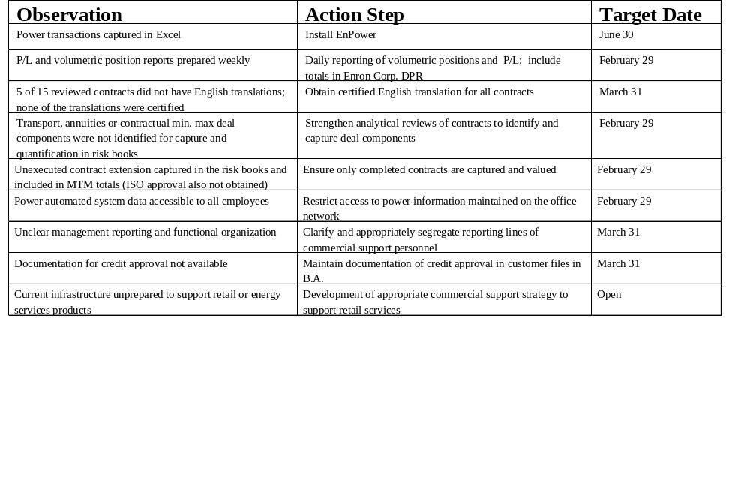
Project Doorstep - Buenos Aires Observations

Slide 6
Project Doorstep - Buenos Aires Observations
AREAS FOR FURTHER REVIEW
Office profitability and liquidity analysis (including major components)
Cash forecasting and reporting
Cash disbursements controls
Existence of side agreements
EnPower post implementation
Supporting Houston operations

Slide 7
Project Doorstep - Buenos Aires
Office Analysis Framework
Market Structure - Power
Primarily physical market environment, financial transactions recently executed.
Open access distribution market for customers larger than 50kw hours, regulated tariff structure in place.
Generation is fully deregulated and power is available for sale on spot or contractual basis up to the facilities capacity.
Independent Service Operator controls transmission system.
Peak demand analyzed as approximately 12,750 mw, 19,490 mw available.
Power generation approximately 50% thermal, 45% hydro, 5% nuclear in WEM.
Contracts executed for one year minimum, must be reported and accepted by regulatory agency.
Market Structure - Natural Gas
System privatized at all levels (production, transportation, and distribution)
Currently a physical market, no financial transactions.
Open access to all customers larger than 3mm cm/year.
Two major firm supply transactions with expiration in 2004, one transport deal with expiration in 2009.
Market dominated by single major player, YPF, produces 40% and markets 55% of gas total supply.
Limited volatility in natural gas and transportation pricing. Transport is approximately 40% of total price.
Opportunities available to exploit market for transportation.
Strategy
Continuing focus on expansion of natural gas and power portfolios and development of “commodities” market.
Limited success on industrials; however, 6mm commercial/retail customers in GBA.
Expansion into power financial transactions.
Pursue opportunities to capitalize on firm vs. interruptible transport.
Explore possibilities of acquiring generation assets and associated market opportunities.

Slide 8
Project Doorstep - Buenos Aires
Office Analysis Framework
Management
Management and operational staff control oriented.
Commercial and operations groups primarily locals, few key positions held by seasoned Enron personnel.
Several energy operations support functions performed in Houston, rapid portfolio expansion may necessitate local operations.
Movement to have overall employee portfolio supported by locals.
Management supportive of rotating key employees through similar functions in Houston to further develop employees knowledge and experience.
Information
Positions for power and natural gas distributed to trading management and traders weekly
New deal reports prepared and reviewed by traders weekly.
Southern Cone Trading Risk Profile (positions and YTD p&l) delivered to senior management weekly.
Monthly cash position and estimated profit and loss statement reports delivered for review by Southern Cone senior management.
Systems
Natural gas transactions utilize established Houston trading systems (i.e., ERMS, CPR)
Power activity captured on Excel spreadsheets.
Financial Reporting information captured in newly installed SAP.
Power valuation model developed in Excel

Slide 9
Project Doorstep - Buenos Aires
Office Analysis Framework
Business Processes
Back-office coordination between Houston and BA:
Deal Documentation, Capture and Risk Management in Houston.
Logistics, Settlements, and Financial Reporting in BA.
Position reports prepared for distribution in Risk Management weekly.
Deal information prepared by traders and delivered to Houston for risk identification and capture in trading portfolios.
Credit approval coordinated with GCG in Houston.
Financial settlements approved by Houston operations and BA traders prior to mailing.
Competitors
Natural Gas - two LDC owed marketers and recently licensed Duke Energy.
Power - Recent licensed Duke and one other registered marketer.
Counterparties
Natural Gas - YPF, Quintana, Totalassa, Cerro Vanguardia, Bagleysa, Gases de Ensenada.
Power - Perez Companc, Centeral Termica Alto Valle S.A., Firestone, Electrometalurgica Andina, Praxair.

Slide 10
Project Doorstep-Buenos Aires
Review Highlights
DEAL PORTFOLIO
Gas:
9 current deals, all physical
Terms are generally for 1 year or more, the longest dated deal runs through November 2012
Pricing is based on published index and transport which each change twice per year.
Transport contracts include 1 firm and 3 interruptible
As of February 18, 2000:
  Net Open Postion- (5.4 BCF)
  YTD P/L- ($. 8) MM
The review was performed on 5 of the 9 current deals.
1 firm transport and 1 interruptible agreements were reviewed.
Power:
21 current power deals; 19 physical, 2 financial
Terms must be at least 1 year, the longest term deal is two years
Transport is not included in any of the deals
As of February 18, 2000:
  Net Open Position- (0.7 MM Mwh)
  YTD P/L- ($ .1) MM
The review was performed on 9 of the 21 deals.

Slide 11
Project Doorstep - Buenos Aires Observations
CONTROL IMPROVEMENTS
Install EnPower for power transactions by June 30, 2000.
  -Power transactions are currently captured in an Excel model
Report P/L and positions daily for inclusion in Enron Corp. DPR
  - P/L and position reports are prepared and forwarded to Houston weekly
Translate all contracts into English by a certified translator
  -5 of 15 reviewed contracts did not have English translations; none of the translations were certified
Strengthen analytical reviews of contracts to identify all risk components.
  -Identify and capture each risk component (i.e. transport, annuities, contractual min.max)
Ensure only completed contracts are captured and valued
-One contract extension that had not yet been executed by the counterparty
or approved by the ISO was included in MTM valuation
Restrict access to power information maintained on the office server by March 30, 2000
Clarify and appropriately segregate reporting lines of back office personnel
Maintain documentation of credit approval in customer files in B.A.

